Slide 1
Clustering
Analyze the clustering performance of k-Means
Tomasz Janeczko, Lukáš Hofman

Slide 2
Problem
…
…

Slide 3
Possible methods

Slide 4
Different approaches with methods
…
…
…
…

Slide 5
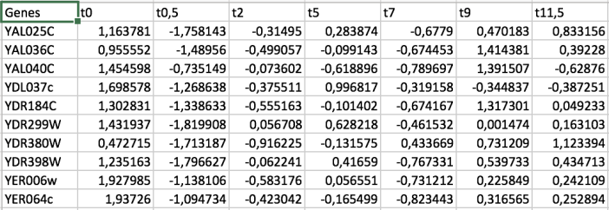
Our dataset
We use the provided dataset, which can be found in sporulation-filtered.txt
8 columns: Genes t0 t0,5 t2 t5 t7 t9 t11,5
Number of genes: 474
Number of time intervals: 7
We normalize the dataset

Slide 6
Our code - 1

Slide 7
Our results - 1 (are they relevant?)

Slide 8
Our code - 2

Slide 9
Our results – 2 (are they relevant?)

Slide 10
Comparison of the results

Slide 11
Conclusion and analyze of the performance

Slide 12
Thank you for your attention
Co-authors:
Tomasz Janeczko, Lukáš Hofman
https://github.com/LuhiHofi/Aprendizaje-Computacional
Lab 1 Task
Aprendizaje Computacional (2024-25)
Universidad de Málaga

